Slide 1
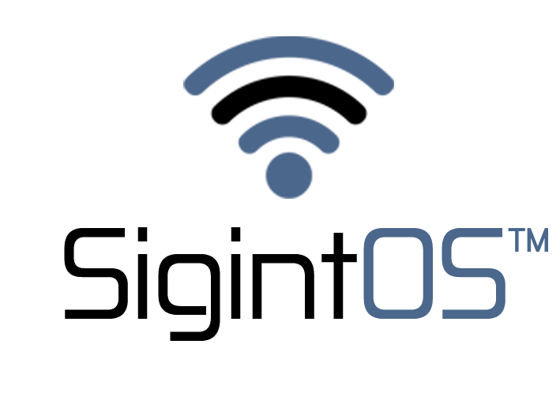
SIGNALS INTELLIGENCE platform presentatıon

Slide 2
All materıals shown ın thıs presentatıon are for ınformatıonal purposes only. The SIGINTOS™ brand owner ıs the owner of thıs presentatıon and cannot be held responsıble for legal actıons arısıng from ıts use outsıde the owner.

Slide 3
Sıgınt platform
SIGINT PLATFORM PRESENTATION 08-2022

Slide 4
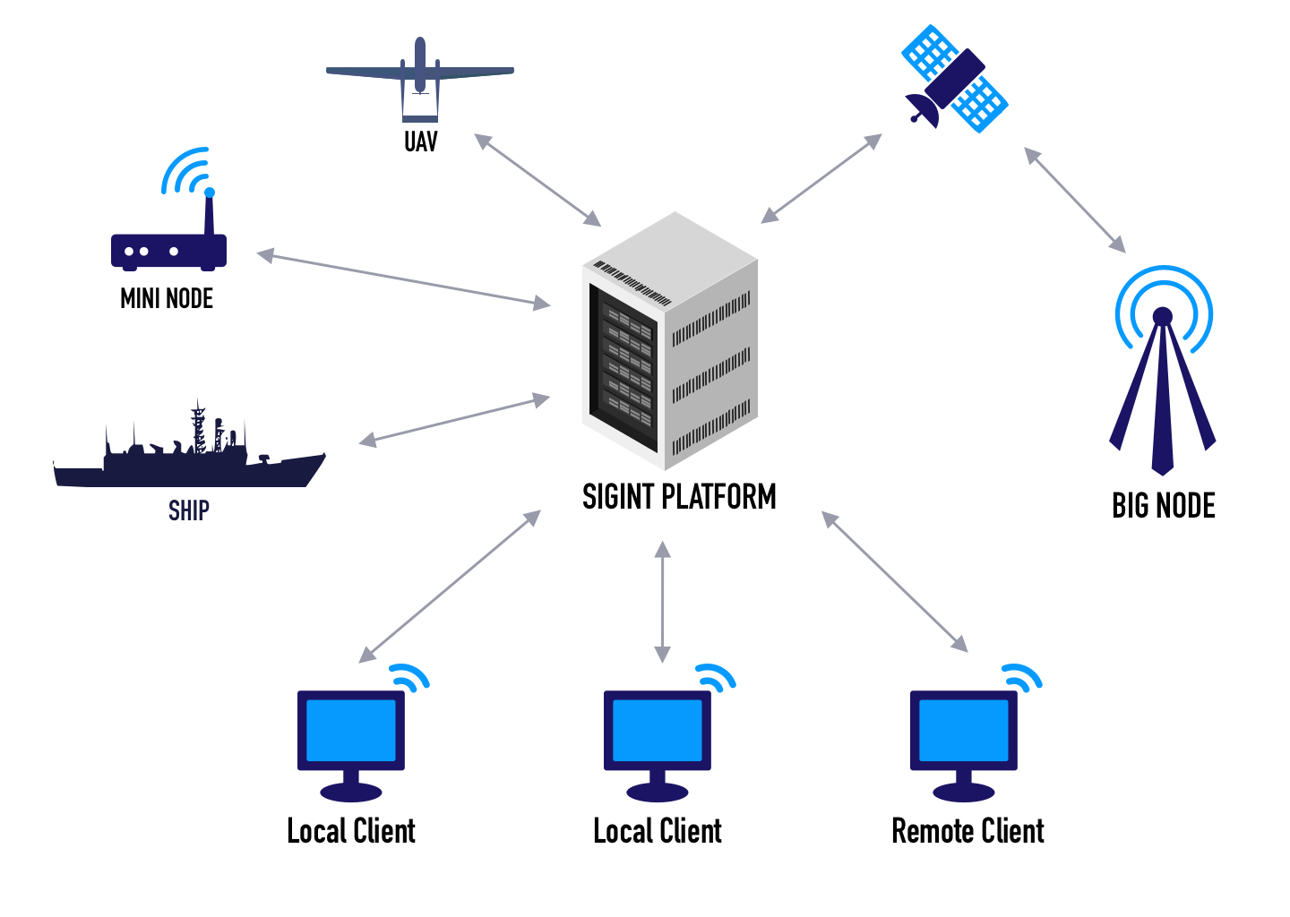
PLATFORM NODES
Data flowing from all field components is collected and interpreted by SIGINT PLATFORM and stored in units.
With Local and Remote connections, the data is displayed on the screen and made sense by passing through various processes.
SIGINT PLATFORM PRESENTATION 08-2022

Slide 5
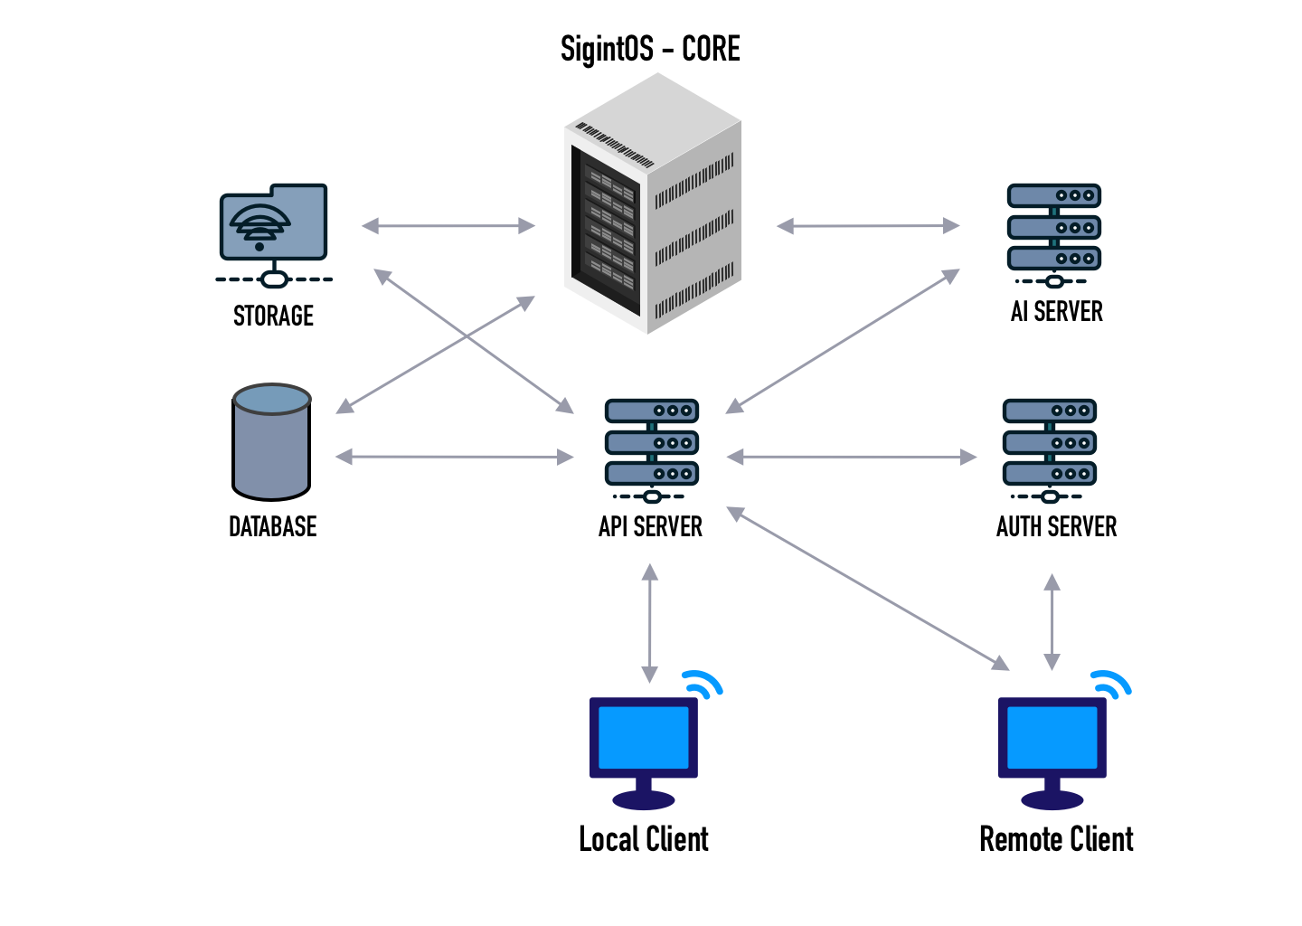
PLATFORM STRUCTURE
All data flowing to the platform is recorded in Storage and Database.
Local Client obtains the desired data by querying the API Server.
After the Remote Client authenticates over the AUTH Server, it accesses the data over the API Server.
Artificial intelligence operations take place on the AI Server.
SIGINT PLATFORM PRESENTATION 08-2022

Slide 6
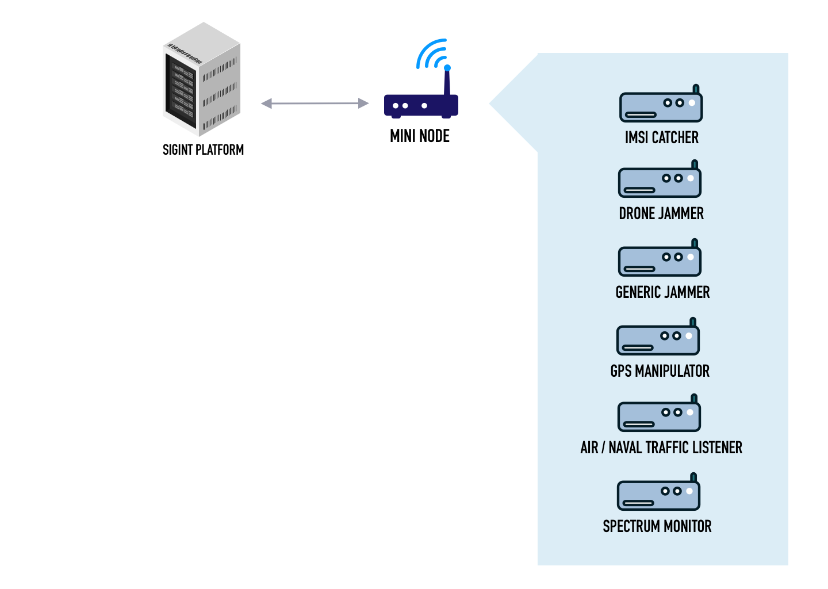
NODES
MINI NODE
MINI NODE; It is easily portable. It performs operations according to many different hardware and radio receivers in its content. These operations can be added or removed as modules.
SIGINT PLATFORM PRESENTATION 08-2022

Slide 7
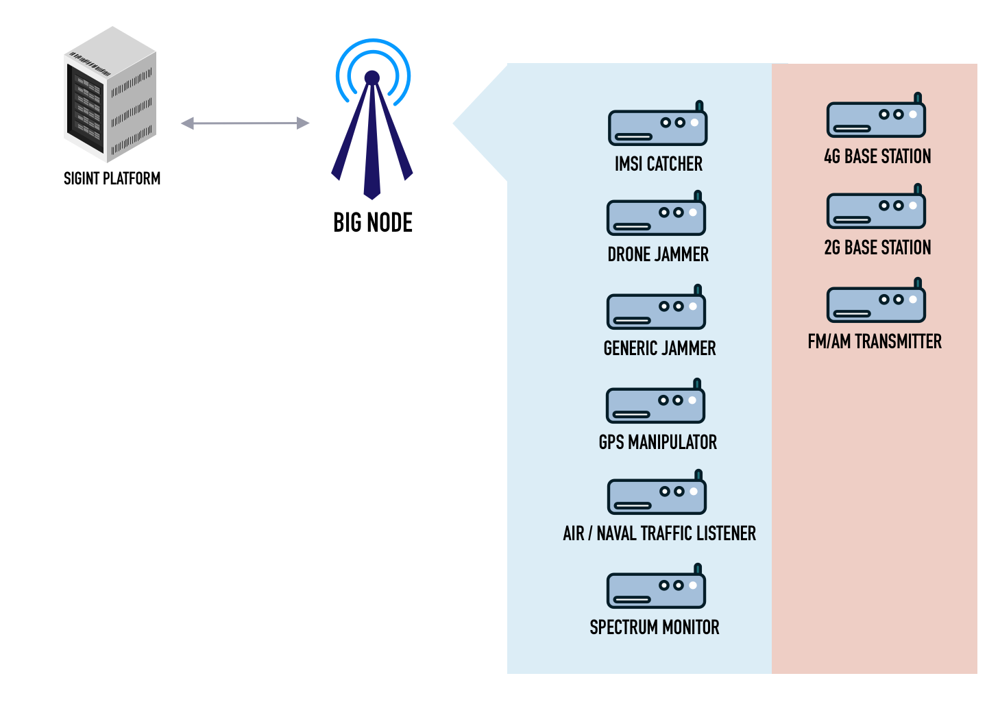
NODES
BIG NODE
MINI NODE; It is easily portable. It performs operations according to many different hardware and radio receivers in its content. These operations can be added or removed as modules.
In addition, FM and AM broadcasts can be made and 4G and 2G networks can be created completely privately.
SIGINT PLATFORM PRESENTATION 08-2022

Slide 8
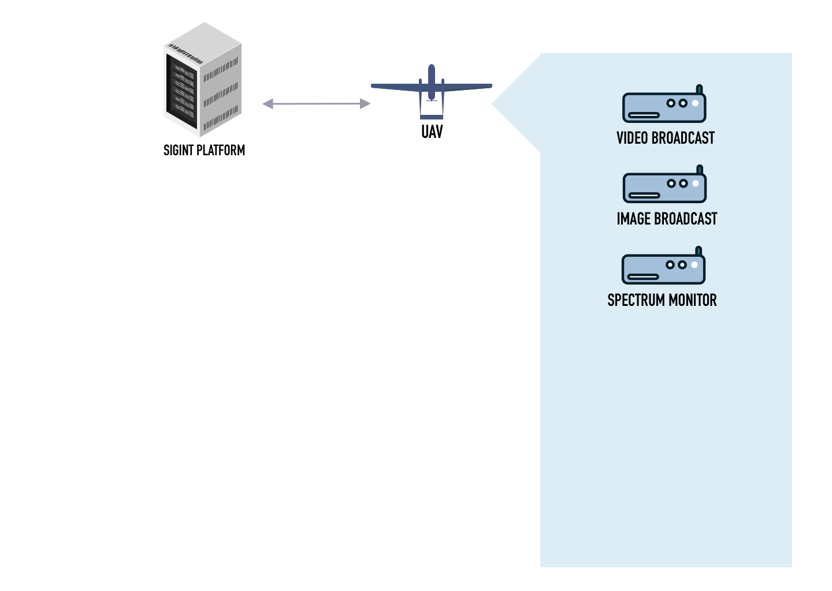
NODES
UAV
Video and images transferred from Unmanned Aerial Vehicles are collected and interpreted by the Platform. Spectrum Monitor with the data coming from the radio receivers on the Unmanned Aerial Vehicle.
SIGINT PLATFORM PRESENTATION 08-2022

Slide 9
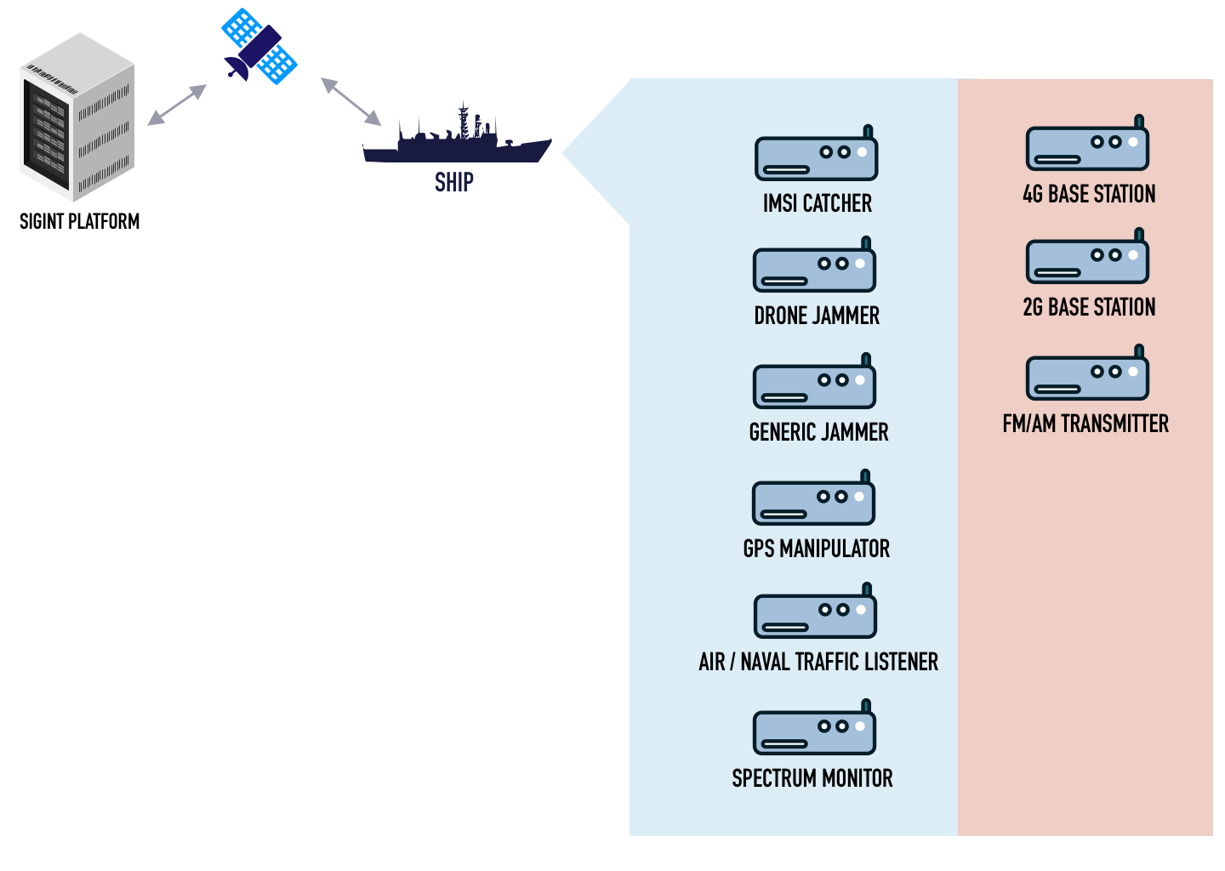
NODES
SHIP
With the BIG NODE system on the marine vehicles, the data is collected and interpreted by the Platform. These data are performed on the Platform via external world connections such as Satellite, Radio Link.
SIGINT PLATFORM PRESENTATION 08-2022

Slide 10
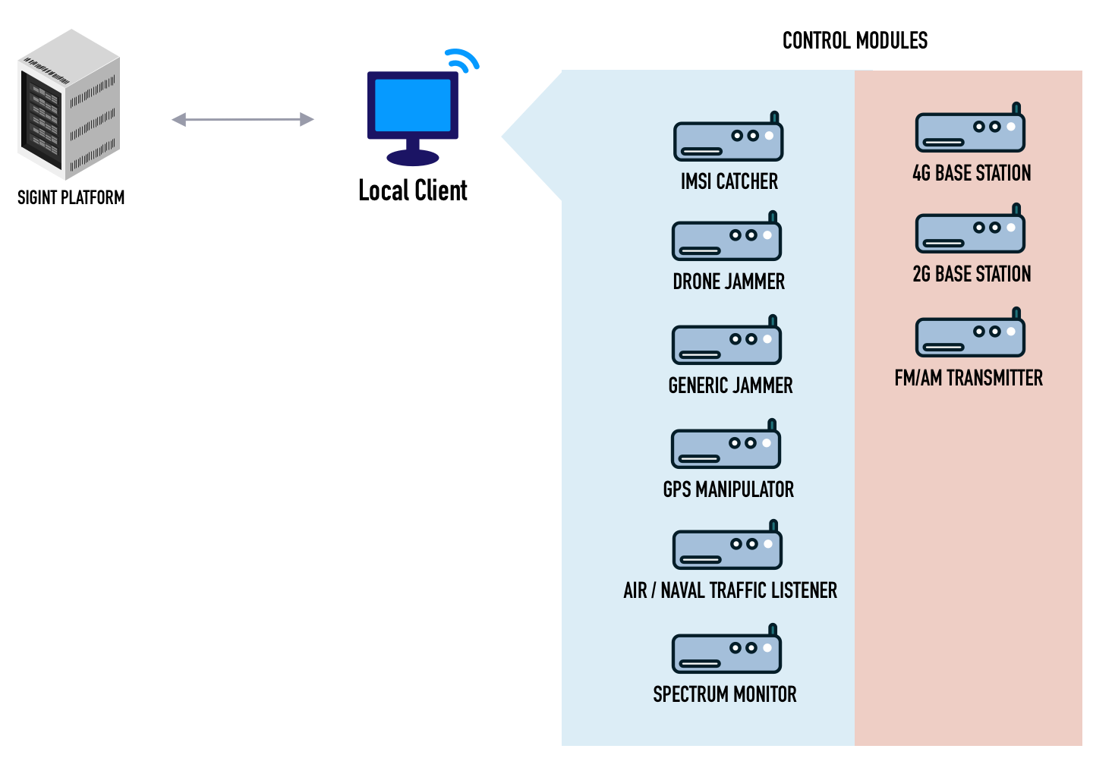
NODES
LOCAL CLIENT
Local Client; It can perform data exchange by using all modules on the NODE it connects to. Artificial intelligence can perform operations on this data. Local Client operation management
SIGINT PLATFORM PRESENTATION 08-2022

Slide 11
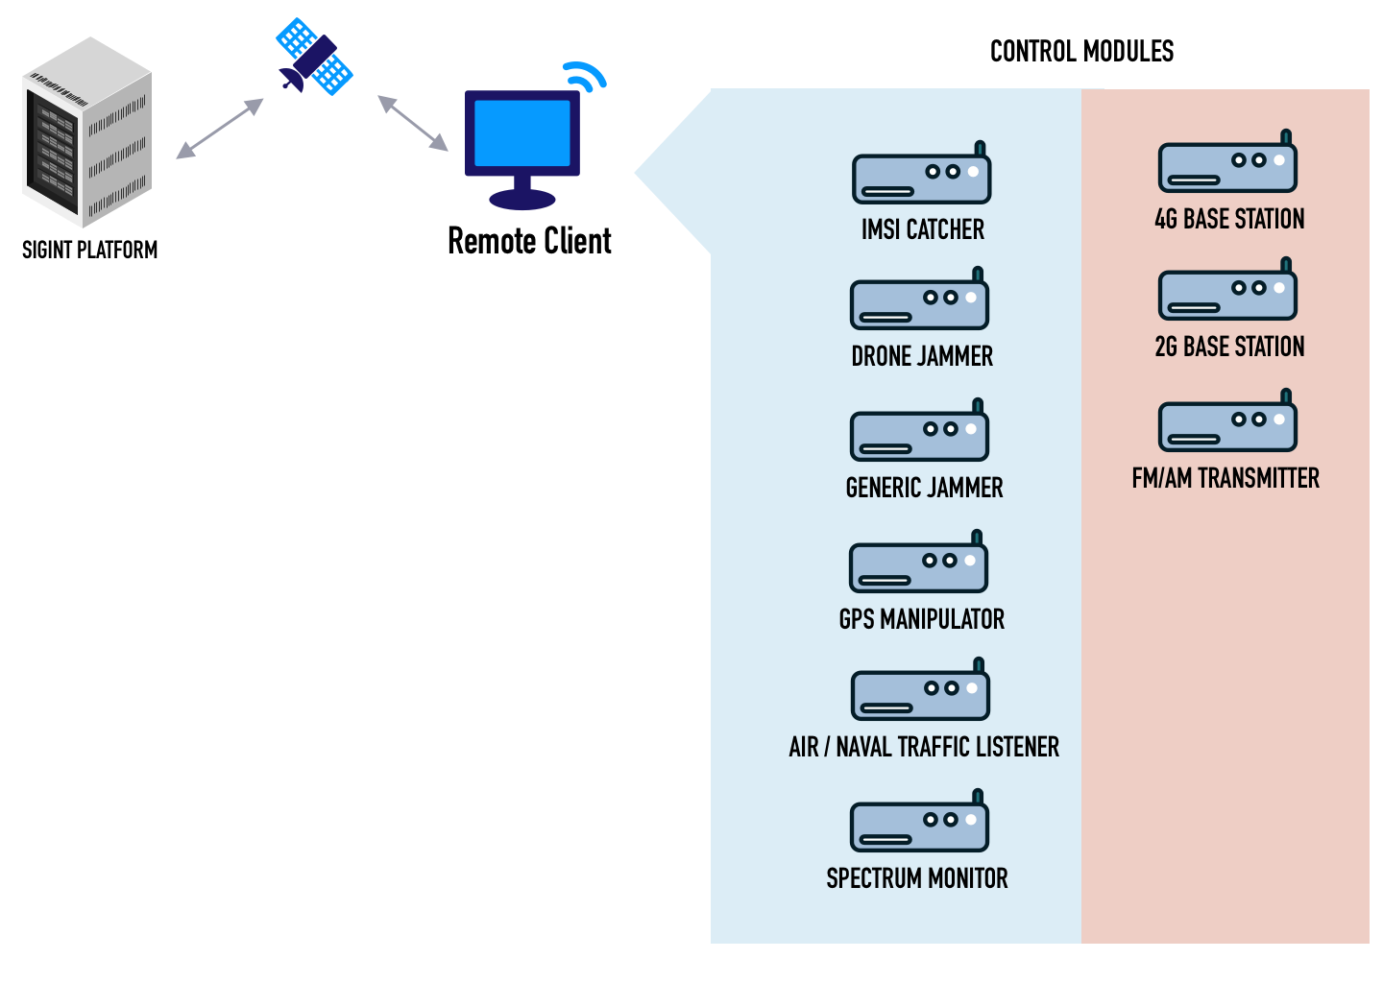
NODES
REMOTE CLIENT
Remote Client; After performing identity control with remote connection, it can perform data exchange by using all modules on NODE. Artificial intelligence can perform operations on this data. Local Client is located in the operation management center.
SIGINT PLATFORM PRESENTATION 08-2022

Slide 12
OPERATION CENTER
By establishing a connection to all NODEs through the Operations Center, the desired data is displayed on the screens instantly. At the same time, artificial intelligence-supported operations can be performed by displaying historical records on the screen.
SIGINT PLATFORM PRESENTATION 08-2022

Slide 13
SIGNALS INTELLIGENCE platform presentatıon

